Slide 1
Tropical Layer Robustness Implemented in Convolutional Neural Network
5421
Updated: 4/5/2023

Slide 2
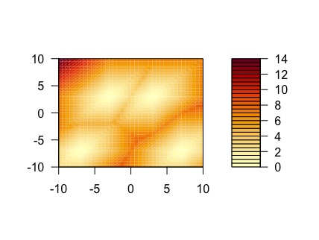
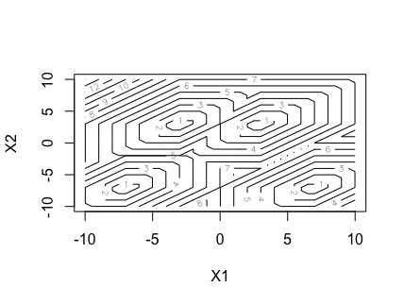
Regularizer
Idea: Compute the pairwise tropical distance between all points, penalize the loss function with the minimum distance.
Code:
class TropRegIncreaseDistance(regularizers.Regularizer):
def __init__(self, lam=1.0):
self.lam = lam
def __call__(self, weight_matrix):
reshaped_weights = expand_dims(weight_matrix,1)
result_addition = reshaped_weights + transpose(reshaped_weights, perm=[1, 0, 2])
tropical_distances = reduce_max(result_addition, axis=2) - reduce_min(result_addition, axis=2)
n = shape(tropical_distances)[0]
mask = band_part(ones((n, n), dtype=bool), 0, -1)
flat_vector = boolean_mask(tropical_distances,logical_not(mask))
return exp(-reduce_min(flat_vector))

Slide 3
Regularizer
class TropRegIncreaseDistance(regularizers.Regularizer):
def __init__(self, lam=1.0):
self.lam = lam
def __call__(self, weight_matrix):
reshaped_weights = expand_dims(weight_matrix,1)
result_addition = reshaped_weights + transpose(reshaped_weights, perm=[1, 0, 2])
tropical_distances = reduce_max(result_addition, axis=2) - reduce_min(result_addition, axis=2)
n = shape(tropical_distances)[0]
mask = band_part(ones((n, n), dtype=bool), 0, -1)
flat_vector = boolean_mask(tropical_distances,logical_not(mask))
return exp(-reduce_min(flat_vector))

Slide 4

Using Tropical Distance to Make Logits
Summary of Method: Make last layer of neural network activated by the softmin of the tropical distance, logits produced are then used to calculate loss
Layer Implementation Below:
class TropEmbedMaxMinLogits(Layer):
def __init__(self, units=2, initializer_w=initializers.random_normal, lam=0.0, **kwargs):
super(TropEmbedMaxMinLogits, self).__init__(**kwargs)
self.units = units
self.initializer_w = initializer_w
self.lam = lam
def build(self, input_shape):
input_dim = input_shape[-1] # Extract the last dimension from input_shape
self.w = self.add_weight(name='tropical_fw',
shape=(self.units, input_dim),
initializer=self.initializer_w,
regularizer=TropReg(lam=self.lam),
trainable=True)
self.bias = self.add_weight(name='bias',
shape=(self.units,),
initializer="zeros",
trainable=True)
super(TropEmbedMaxMinLogits, self).build(input_shape)
def call(self, x):
x_reshaped = reshape(x,[-1, 1, self.w.shape[-1]])
x_for_broadcast = repeat_elements(x_reshaped, self.units, 1)
result_addition = x_for_broadcast + self.w
trop_distance = reduce_max(result_addition, axis=(2)) - reduce_min(result_addition, axis=(2)) + self.bias
negative_exponents = exp(-trop_distance)
softmin_values = negative_exponents / reduce_sum(negative_exponents, axis=-1, keepdims=True)
return softmin_values

Slide 5
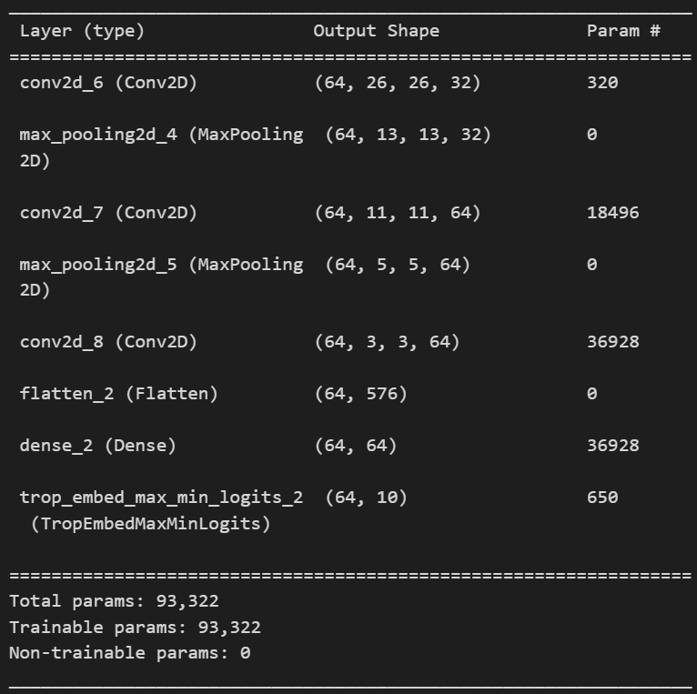
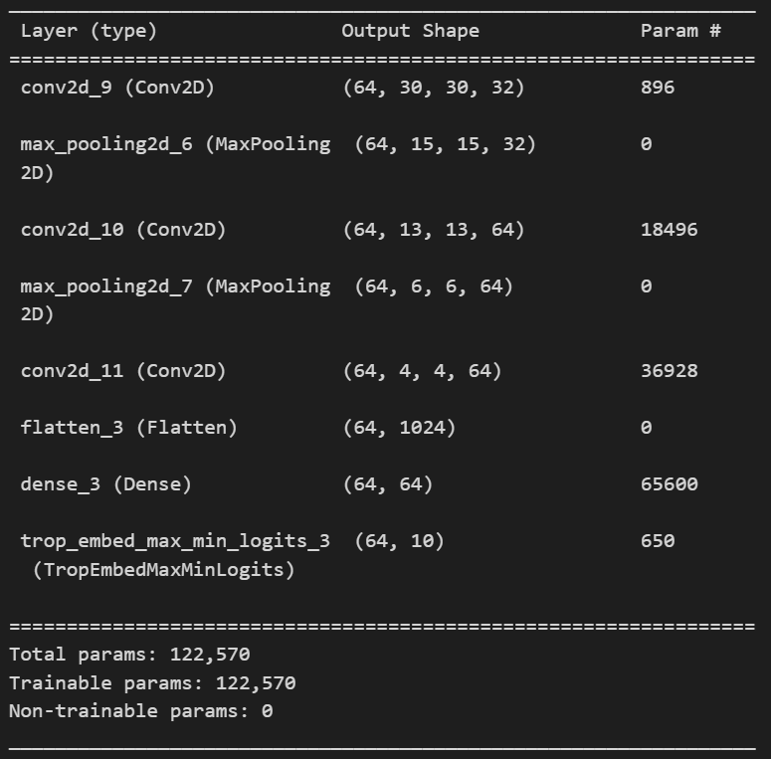
Using Tropical Distance to Make Logits
Model used for testing:
model = Sequential([Conv2D(32, (3, 3), activation='relu'),
MaxPooling2D((2, 2)),
Conv2D(64, (3, 3), activation='relu'),
MaxPooling2D((2, 2)),
Conv2D(64, (3, 3), activation='relu'),
Flatten(),
Dense(64, activation='relu'),
TropEmbedMaxMinLogits(10)])
Model structure for MNIST: (28,28,1)
Model structure for SVHN and CIFAR: (32,32,3)

Slide 6
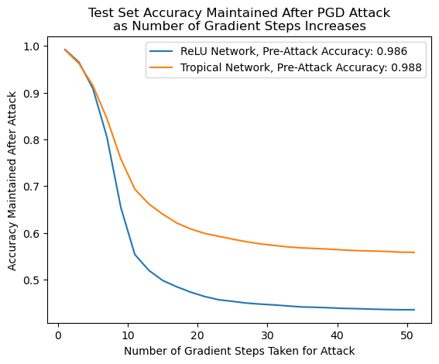
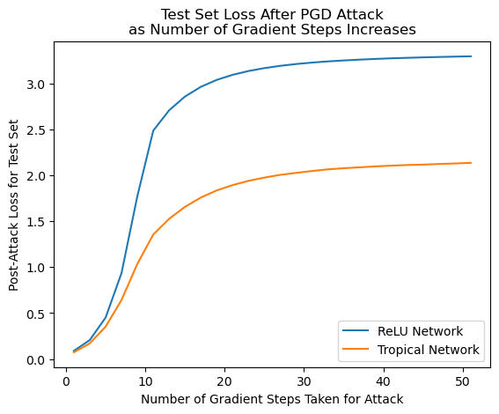
MNIST – Logits, PGD attack 0.1

Slide 7
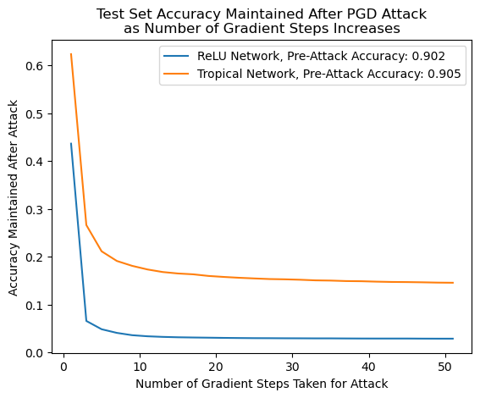
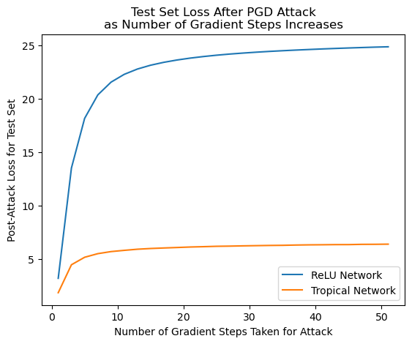
SVHN – Logits, PGD attack 8/255

Slide 8
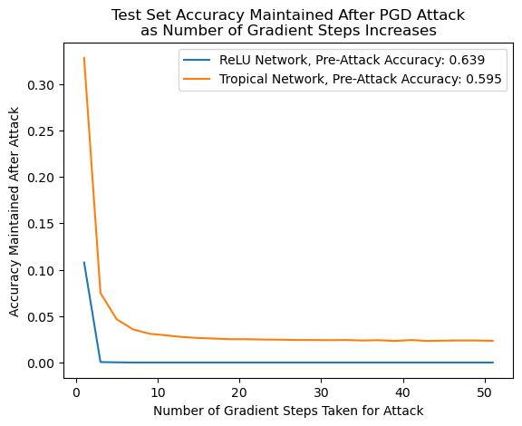
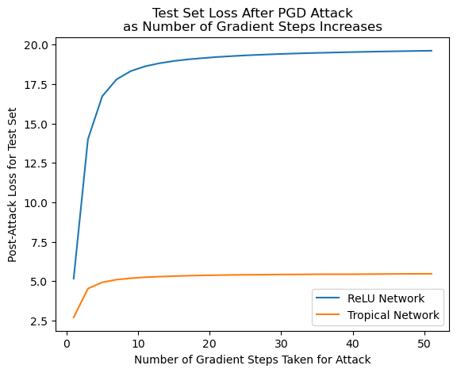
CIFAR - Logits , PGD attack 8/255

Slide 9
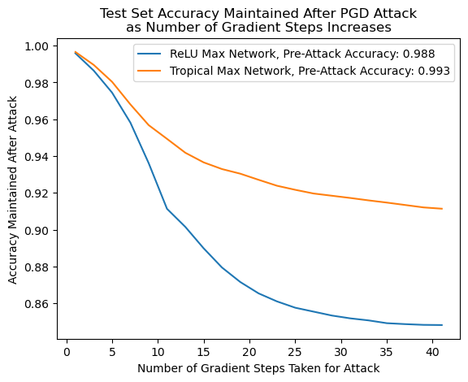
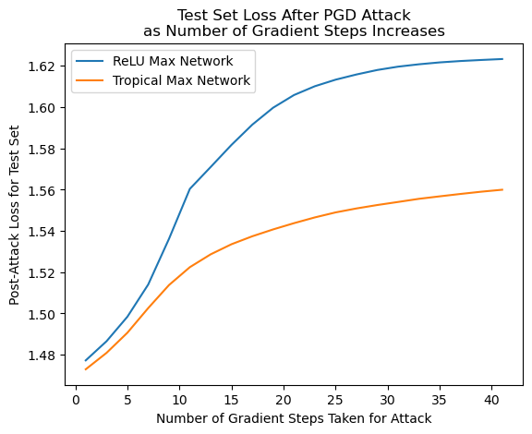
MNIST – Max w/ p=3

